Slide 1
IBM Data analyst capstone project by Harsha Kanaparthi 5th July 2024

Slide 2
agenda
Executive Summary
Introduction
Methodology
Results
Discussion
Conclusion
Appendix

Slide 3
Executive Summary
To remain competitive in the global IT sector, it's essential to stay abreast of ever-changing technologies. This report uses data analytics to highlight current and projected trends in the demand for skills related to programming languages, databases, and other technologies. It also examines the demographics of professionals in the technology sector.
Data was gathered from a Stack Overflow survey, IBM's website, and GitHub job postings. It was collected, cleaned, subjected to exploratory analysis, and visualized on dashboards.
The findings show that JavaScript is currently the most popular programming language and is anticipated to remain so in the future. MySQL has the highest current database usage, but PostgreSQL is projected to have more demand moving forward.

Slide 4
Introduction
This presentation report utilizes data analytics to highlight current and projected trends in the need for skills related to programming languages, databases, platforms, and web frameworks.
The analysis investigated several key inquiries: Which programming languages are most in demand today? What are the most sought-after database skills? What are the popular IDEs or web frameworks?
The target audience for this research includes IT professionals, HR managers, and anyone interested in the IT sector who wants to learn about the top in-demand IT skills that will continue to be relevant in the future.

Slide 5
Methodology
Data was collected in various formats, such as the number of job postings for different technologies and locations, using the GitHub Jobs API through Python.
To obtain information on programming languages and their annual salaries, the IBM website was scraped. Additionally, the dataset from the 2019 Stack Overflow developer survey was downloaded and saved.
The data was cleaned and analyzed using Python. An exploratory data analysis (EDA) was conducted to assess the distribution of the data, identify outliers, and determine correlations between various columns in the dataset. Charts, graphs, and dashboards were created using Python and Cognos Analytics to visualize the data.
All Python analyses were carried out in Jupyter Notebook through Visual Studio.

Slide 6
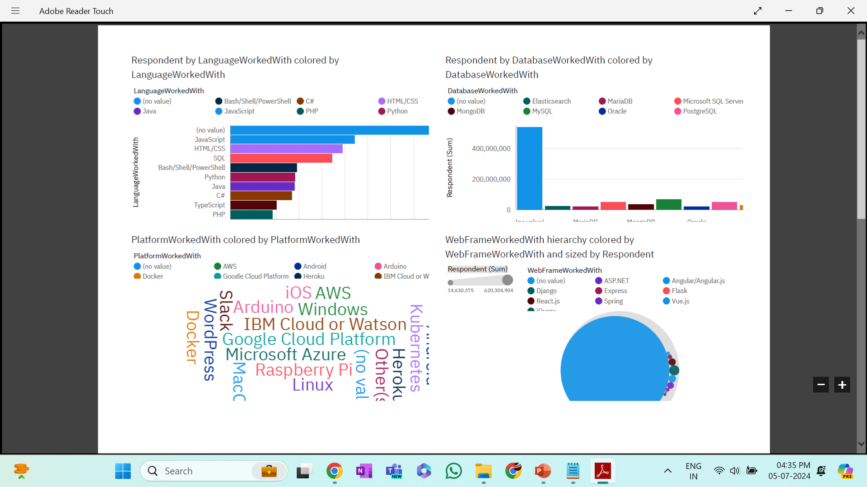
Results
1. Programming language Trends

Slide 7
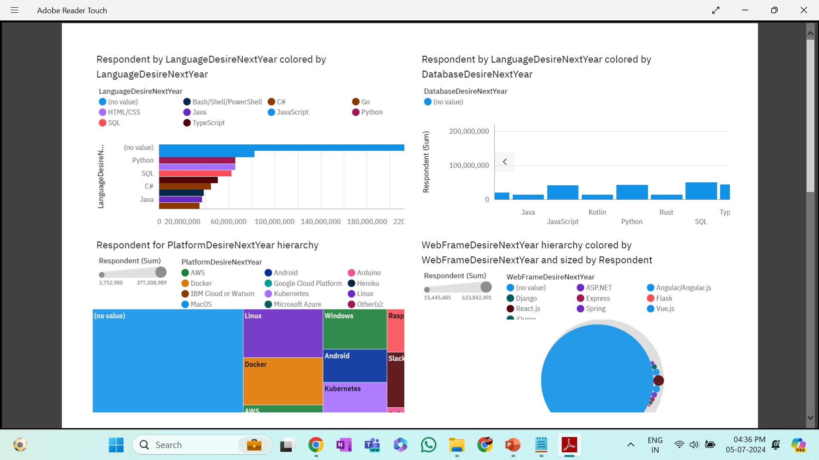
Data Base Trends

Slide 8
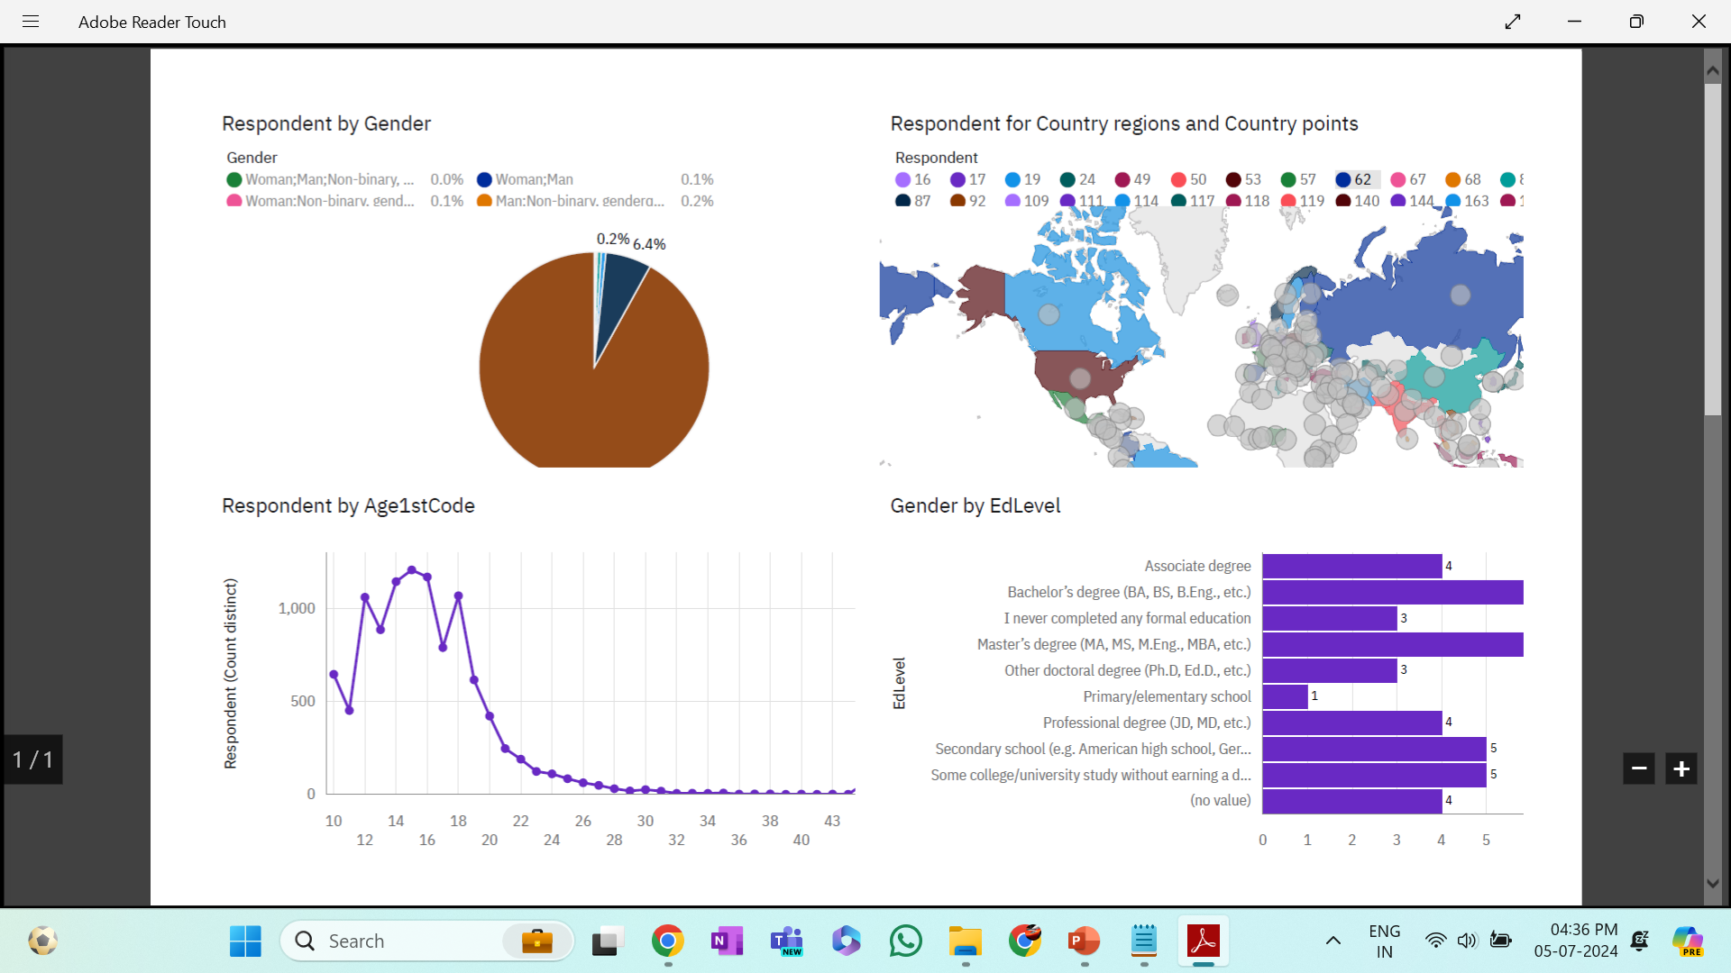
DAHBOARD Trend 3

Slide 9
Discussion
The technology sector requires continuous upskilling to keep pace with advancements. Addressing the wide gender gap in the industry remains a significant challenge.
Furthermore, the necessity of completing a master's or doctorate degree in technology fields is debatable. The increasing demand for mobile development is evidenced by the rising popularity of Kotlin.
There is also a need for more tech education, access, and development in less developed regions in Southeast Asia, South America, Africa, and parts of Europe.
Finally, the future relevance of Oracle SQL is uncertain, raising questions about its longevity and continued importance in the industry.

Slide 10
Conclusion
The findings from this report underscore the importance of staying updated with current trends and skills in the IT sector. JavaScript remains the leading programming language, and PostgreSQL is expected to surpass MySQL in demand.
Continuous upskilling and addressing the gender gap are crucial for the sector's growth. Additionally, enhancing tech education and access in underdeveloped regions can create more opportunities and drive global technological advancement.
The analysis provides a clear picture of current trends and offers insights into the future needs of the technology sector, helping stakeholders make informed decisions.

